Slide 1
AGILE-BASED QUALITY TESTING
The following framework describes automated, inclusive testing, principal roles, and RACI testing.
23 Pages 20-1314

Slide 2
Agile-Based Quality Testing Framework
(Templates filled in with examples from the TORUS projects)

Slide 3
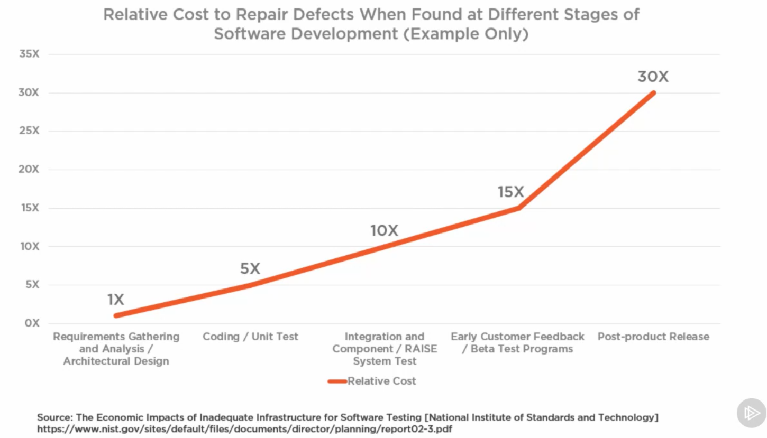
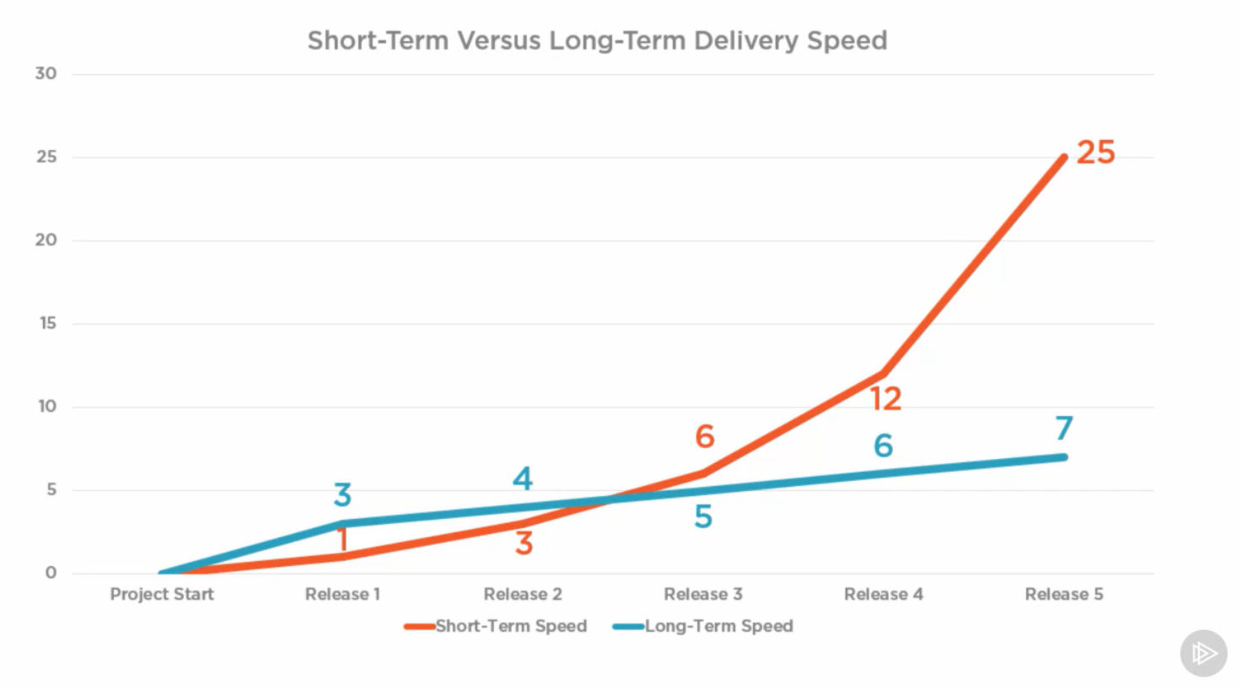
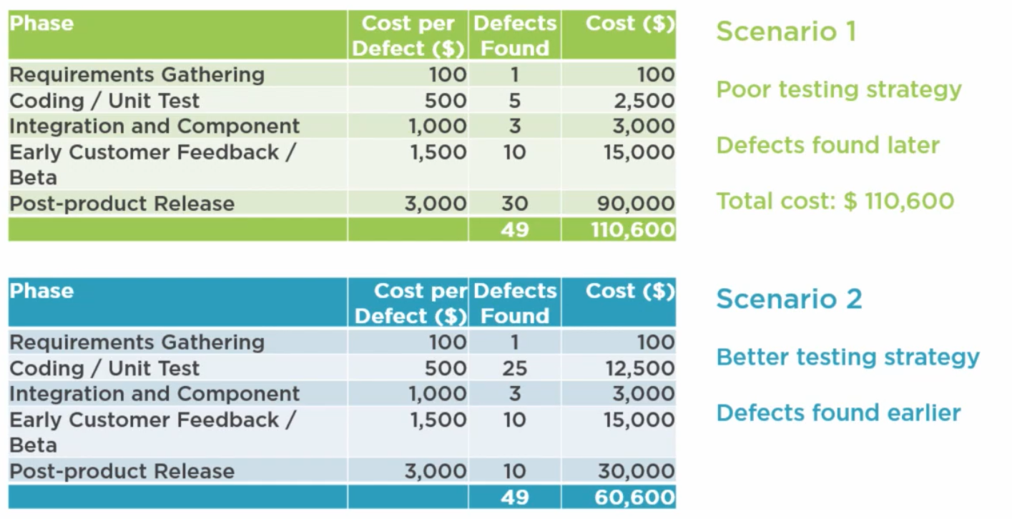
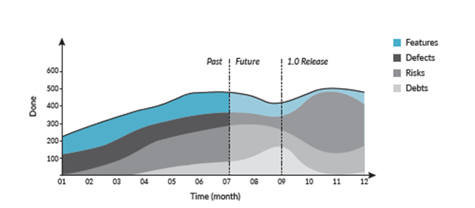
TCO and Benefits of Testing

Slide 4
Understanding / Scope of Common Terms
Area | Description
Agile Epic | High level description of business need or objective – Generally takes several sprints to achieve and is made up one several stories that define specific business needs, rules and requirements within that area.
Agile Story | Provides a short, simple description of a need/feature/business requirement, both functional and non-functional, from the user’s perspective and can contain one or more business rules. A good practice is to follows Bill Wake’s INVEST method to define a story using acceptance criteria agreed by the users that can be tested. (A good testing format for each business requirement or rules is Gherkin notation THIS IS CRITICIAL to testing as you cannot determine if a test is successful or fails without pre-defined and agreed requirements. Full and active customer involvement in defining these is critical (mandatory) both during the definition and pre-agreement of the tests, and during user acceptance testing (UAT) to ensure a fully functional system is tested and meets expectations, functionality and service levels are delivered. Without this the system is "being built on sand" with a high risk of failure.
INVEST | Bill Wake created a good reminder of the characteristics of a good quality product when writing an Agile story. This is good in general, not just for agile areas such as Scrum backlog, Kanban board or XP project, but also in service and object orientated architectures or just breaking down a problem Letter Meaning Description I Independent The Product Backlog Item (PBI) should be self-contained, in a way that there is no inherent dependency on another PBI. N Negotiable PBIs are not explicit contracts and should leave space for discussion. V Valuable A PBI must deliver value to the stakeholders. E Estimable You must always be able to estimate the size of a PBI. S Small PBIs should not be so big as to become impossible to plan/task/prioritize within a level of accuracy. T Testable The PBI or its related description must provide the necessary information to make test development possible.
Gherkin notation | Gherkin is simplified line-oriented language just like YAML and Python. It is written in a user understandable form that details cause and effect of inputs and outputs of a test linked to a requirement. (It does require high levels of business participation and can increase testing costs if done poorly). Examples are process step tests, a business rule tests, etc. The notation uses simple terms like “Given”, “When”, “Then”, “And” and “But” to define the scenario that needs to be tested. An example is: Feature: User Authentication Background: Given the user is already registered to the website Scenario: Given the user is on the login page When the user inputs the correct email address And the user inputs the correct password And the user clicks the Login button Then the user should be authenticated And the user should be redirected to their dashboard And the user should be presented with a success message This is idea for a business analyst to document many, but not all, Agile stories requirements and tests with the customer. Each scenario should execute separately, and every feature should be able to be executed along, with steps shown independently. There are testing tools that can use Gherkin notation and generate automated tests.

Slide 5
Understanding / Scope of Common Terms
Area | Description
Approval Stages (Manual/Automated) | Points in the integration and deployment processes that require an approval before the process can proceed. The approval can be either automatic by passing some preset criteria or set of tests (e.g. static code analysis), or manual where one or more people must sign off (e.g. user acceptance testing).
Code vs Test Coverage | Code coverage is a measure of code that is executed throughout testing, while test coverage is a measure of how much of the feature being tested is covered by tests. Different parts of the system may have different levels as agreed by Project, IT and Quality leadership.
Continuous Integration / Continuous Deployment (CD/CD) | Continuous Integration (CI) is the process of integrating code into a mainline code base. This allows for developers to work on sections of the system independently and them merge them when ready. Continuous Deployment (CD) is more complicated. CD is about the processes that happens after code is integrated for changes to be delivered to users. Those processes involving testing, staging and deploying code. (You need to have CI before you can have CD for it to be effective)
Minimum Acceptable Testing (MAT) for Minimal Viable Products | Defines the minimum level of testing to ensure both function and non-functional requirements have been met to an acceptable level for the product to be released into production. Different parts of the system may have different levels of acceptable testing as agreed by Project, IT and Quality leadership. This is similar in concept to the “minimum viable product” philosophy.
Quality Assurance | Defect Prevention – Proactive - Planned set of activities necessary to provide adequate confidence that product/service will conform to requirements & meet user needs and prevent bugs or defects. This is done without executing code in the development cycles.
Quality Control | Find & Correct Defects – Reactive - detective quality method focused on identifying defects. This is always done through executing code during testing cycles.
Functional Requirements Testing | Testing of non-functional aspects (performance, usability, reliability, scalability, etc.). It is designed to test the readiness of a system to the agreed service level requirements. (An excellent example of non-functional test would be to check how many people can simultaneously login into a software.) It is quantitative measurements not subjective or qualitative.
Non-Functional Requirements Testing | Testing of function aspects (user Interface, APIs/services, database, security, etc.) meets the business needs/requirements of the features being delivered. Testing functionality, usability, accessibility and error conditions. This includes User Acceptance Testing (UAT)
White Box Testing | White Box Testing examines internal structures and operations of the item being tested. This can both being done statically (e.g. the software code is not executed) or running the code to uncover bugs and defects as operations are executed. There may also be variable injection to induce changes in code behavior or internally logging to show how that code works. The conditions of the test should be explicitly defined as appropriate to provide adequate confidence that item being tested will conform to agreed requirements. Examples are Unit Tests, Static Code Analysis, Integration Tests, Regression Tests, Load/Stress Tests, etc.
Black Box Testing | Black Box Testing does not care about how the item being tested internally works or is coded. It only care about what results are obtained given a set of inputs and initial states. For a given set of inputs (variables and environmental states) you expect to see a resulting set of output (results and environmental states). The environmental can include everything that could alter the outcome from data/time, to where the test is being run and on what platforms, latency injection, etc. The conditions should be explicitly defined as appropriate to provide adequate confidence that item being tested will conform to agreed requirements. This is also used in process mapping using the SIPOC (supplier, input, process, output, customer). Examples are Unit Tests, User Acceptance Tests, Synthetic Tests, Load/Stress Tests

Slide 6
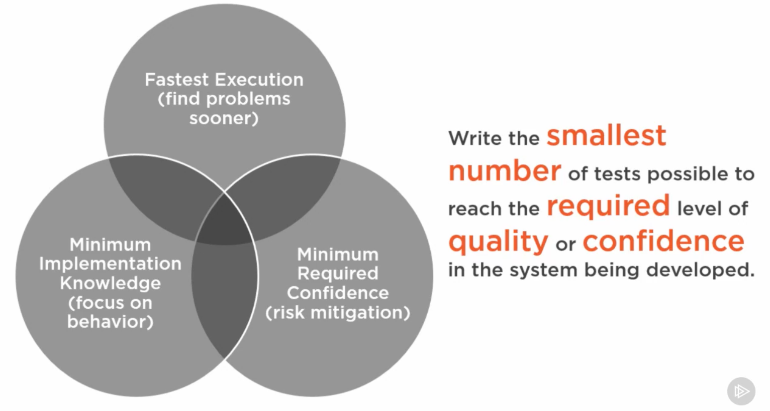
Principles
Automated, as much as possible
End user involvement
Inclusive / team involvement
Pragmatic / appropriate Agile -Minimum Acceptable Testing (MAT) for Minimal Viable Products (MVP)
“Layered Defense” testing
Separations of concerns / tests
Reuse and building test packages
Continuous improvement
Continuous increase
Crawl, Walk, Run Journey / KISS

Slide 7
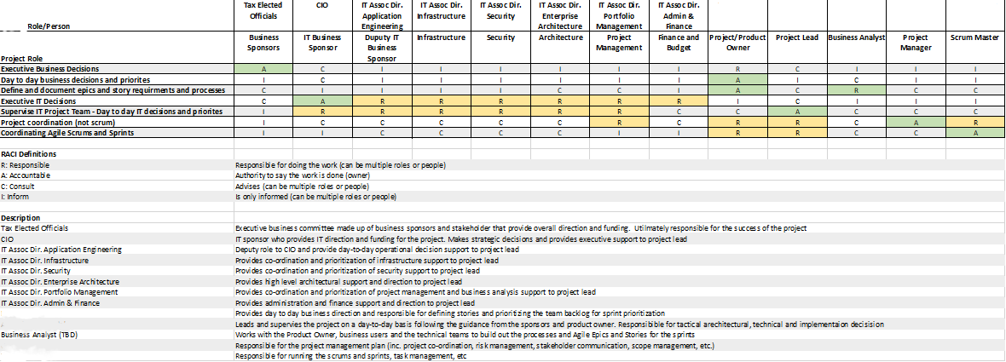
Example RACI for principal roles
Not all project roles are listed (rows in first table), do we want to discuss and include responsibilities for CI/CD and quality explicitly, especially as responsibility varies depending on the testing being done?

Slide 8
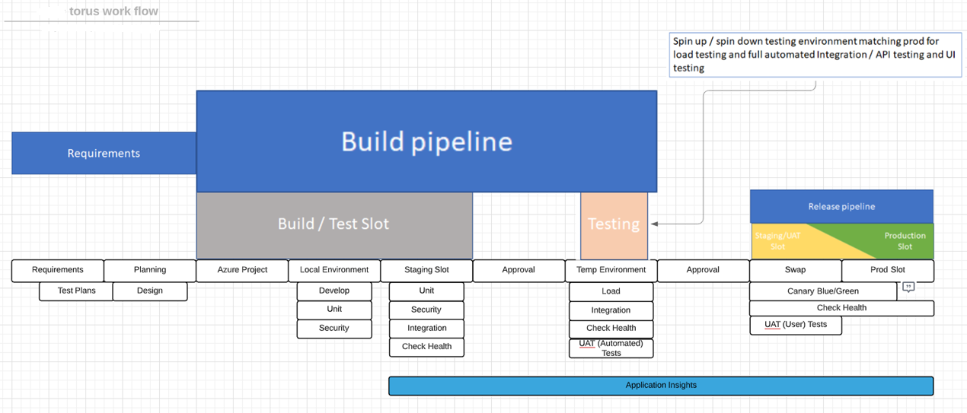
Target (Future Ideal) Quality Test Plan

Slide 9
Types of Tests – Current
None Full Coverage
Current
Desired
 | Area | Test Name | A | I | S | Current and Desired Coverage
1 | CI | Unit (Application Code) Test | X
2 | CI | Static Code Analysis | X | X
3 | CI | Domain Tests (API/Service, Security, Database, etc.) | X | X
4 | CI/CD | Integration Testing | X | X | X
5 | CI/CD | System/Regression Testing (Smoke Packs) |  | X | X
6 | CD | Stress/Load Testing |  | X | X
7 | CD | User Acceptance Testing (Automated) |  |  | X
8 | CD | User Acceptance Testing (User/Manual) |  |  | X
9 | P | Synthetic Testing/Application Performance Monitoring |  |  | X
10 | P | Resilience (Exploration) Testing | X | X | X
CI: Continuous Integration CD: Continuous Deployment P: Production
A: Application Code I: Infrastructure as Code S: Overall System

Slide 10
Tests Coverage Template for an Agile Epic
None Full Coverage
Current
Desired
Epic #/Name: |  |  | Required
 | Area | Test Name | A | I | S | Epic Current and Desired Coverage
1 | CI | Unit (Application Code) Test
2 | CI | Static Code Analysis
3 | CI | Domain Tests (API/Service, Security, Database, etc.)
4 | CI/CD | Integration Testing
5 | CI/CD | System/Regression Testing (Smoke Packs)
6 | CD | Stress / Load Testing
7 | CD | User Acceptance Testing (Automated)
8 | CD | User Acceptance Testing (User/Manual)
9 | P | Synthetic Testing / Application Performance Monitoring
10 | P | Resilience (Exploration) Testing
CI: Continuous Integration CD: Continuous Deployment P: Production
A: Application Code I: Infrastructure as Code S: Overall System

Slide 11
Tests Coverage Template for an Agile Story, as needed
Story #/Name: |  |  | Required
 | Area | Test Name | A | I | S | Accountable | Comments / Link to tests
1 | CI | Unit (Application Code) Test
2 | CI | Static Code Analysis
3 | CI | Domain Tests (API/Service, Security, Database, etc.)
4 | CI/CD | Integration Testing
5 | CI/CD | System / Regression Testing (Smoke Packs)
6 | CD | Stress / Load Testing
7 | CD | User Acceptance Testing (Automated)
8 | CD | User Acceptance Testing (User/Manual)
9 | P | Synthetic Testing/Application Performance Monitoring
10 | P | Resilience (Exploration) Testing
CI: Continuous Integration CD: Continuous Deployment P: Production
A: Application Code I: Infrastructure as Code S: Overall System

Slide 12
Reasons for creating user stories with tests first
In the tradition waterfall development approach, you defined the all functional and non-functional requirements first, then developed, tested, released.
In the Agile development approach, you defined epics and stories, and you create the individual story with tests (each test defines a functional or non-functional requirement), developed, tested, released that unit of work.
The Test (Requirements) Driven Development (TDD) approach allows you to explicitly document requirements up front for a unit of work to ensure to have them understood before starting development.
Using a language like Gherkin allow you to define them in a way they can be understood by the users and automated or used during many test levels. (There are existing frameworks which take the basic Gherkin statement and coverts it into usable test code for testing tools automatically)

Slide 13
Acceptance / Test Case Definition Template for a User Story
Project | (Example from TORUS)
Epic #/Name | Parcel Search
Story #/Name | View-Displaying-the-Parcel-Split-information
Test Number | PRBDI310.1
Test Case | Open the Parcel Split Screen
Statement (Gherkin) - Multiple statements for requirements / business rules that need testing | GIVEN the user is already displaying the parcel information screen GIVEN the split information button is available WHEN the user inputs clicks on the Split button THEN the user should be redirected to the split screen for that parcel
Pre-Conditions | Already authenticated and on parcel screen (Test Number) User is in Parcel Information Screen (Test Number) Parcel Slit option is visible (Test Number)
Environmental State | Development Environment Chrome Browser (Version 86.0.4240.198 - 32-bit) Internal Network Normal Work Hours
Inputs / Test Data | Press Splits button – no additional data needed
Expected Result | Split Screen is visible
Unexpected Results / Errors | 404 Error Message
Actual Result | Split Screen is visible
Link to manual steps / script | None
Link to automatic test project / test code / script | URL to test project
Tool used | White Box: Azure Test Plan / Black Box: Selenium
 | Person | Date Time
Defined By
Developed By
Tested By
Signed Off By
Addendums/Comments/Notes

Slide 14
Scope of Testing
User Acceptance Testing via UI
Selenium Tests
User (Manual) Tests
System / Solution
Synthetic Testing / Application Performance Monitoring / Resilience
Load / Stress &
System / Regression Testing
Integration Testing
Domain Testing
Unit of Code
Unit of Code
Unit of Infra
Unit of Infra
DB table
Unit of Infra
Unit of Infra
Unit of Infra
Unit of Code
Unit Test
Unit of Code
Unit of Infra
Unit of Code
Unit Test
DB table
Unit of Infra
DB table
Static Code Analysis Test
Each type of test can/will overlap other units and test areas (not exclusive in nature)
Tests can be white box, black box or a mixture as appropriate

Slide 15
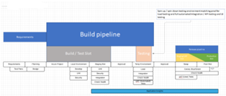
Unit (Application Code) Test
Description: A unit test is a way of testing a unit - the smallest piece of code that can be logically isolated in a system. See VS 2019 Unit Test Documentation
Coverage (current and end of project): 70% (not third-party libraries) -> 85%
Pipeline Position: Development Phase
Automated/Manual Details: Automated test
Tool/Framework: Visual Studio / xUnit.net / Jasmine
Current Practice: Set of white box tests using xUnit and Jasmine where tests are written after the code
Future Ideal State: Testing (TDD) done going through the Red (build to fail test)/Green (build to pass test)/Refactor (build to work in production) development/test cycle. With fully automated testing coverage to the agreed appropriate levels of coverage (see above) incorporated into the CI build pipeline approval process.
Defined By: Developer/Implementor and Business Analyst
Responsibility: Developer/Implementor
Accountable: Developer/Implementor
Controlled/Governed: Project Lead

Slide 16
Static Code Analysis
Description: Examining code to check for adherence to defined best practices, standards, and identify vulnerabilities. Both application and Infrastructure code being analyzed using automation tools.
Coverage (current and end of project): TBD
Pipeline Position: Development Phase
Automated/Manual Details: Automated test
Tool/Framework: TBD - Microsoft Code Analysis tools/extensions and DevOps Kits for Azure that provide these tools (e.g. Microsoft Security Analysis Extension for Azure DevOps)
Current Practice: Combination of manual use (pair programming) of tools
Future Ideal State: All code is passed using the defined set of tools, against pre-defined standards, embedded in the CI pipeline build process.
Defined By: Project Lead & Infrastructure as Code Coordinator
Responsibility: Developer/Implementor and CI/CD pipeline engineer - TBD
Accountable: Developer/Implementor
Controlled/Governed: Project Lead

Slide 17
Domain Tests (API/Service, Security, Database, etc.) - future
Description: Black box testing related to specific areas of the system (such as APIs and services, validating security policies and standards are in followed, etc.) Ensures the area meets the defined non-functional requirements.
Coverage (current and end of project): TBD
Pipeline Position: Continuous Integration Build Phase – Incorporated into Integration Testing at this time.
Automated/Manual Details: Automated test
Tool/Framework: TDB and tools such as the <xx> DevOps Kits for Azure (e.g. Secure DevOps Kit for Azure), Dynamic Code Analyzer, etc.
Current Practice: TBD – Organic growth - We will be doing this at the "run" stage in the crawl, walk, run
Future Ideal State: A cumulative set of pre-defined non-functional tests based on the system requirements determined in the sprints are scripted to run automatically embedded in the CI pipeline build. (As more sprints are done the number of tests increase as they are incorporated into the build process.)
Defined By: Business Analyst, Developer / Implementor & IaC Coordinator
Responsibility: Developer / Implementor and CI/CD pipeline engineer - TBD
Accountable: Developer / Implementor
Controlled/Governed: Project Lead

Slide 18
Integration Testing
Description: Tests that all the different components of the system work together in the manner defined in the non-functional requirement
Coverage (current and end of project): TBD
Pipeline Position: Continuous Integration Build Phase and Continuous Deployment Pre-Release to Production Phase
Automated/Manual Details: Automated test
Tool/Framework: TBD
Current Practice: TBD
Future Ideal State: A cumulative set of pre-defined non-functional integration tests based on the system requirements determined in the sprints are scripted to run automatically embedded in the CI pipeline build. (As more sprints are done the number of tests increase as they are incorporated into the build process.)
Defined By: Business Analyst and Developer / Implementor and CI/CD pipeline engineer - TBD
Responsibility: Developer / Implementor and CI/CD pipeline engineer - TBD
Accountable: Project Lead
Controlled/Governed: IT Executives (Application Engineering, Infrastructure, Security and Enterprise Architecture)

Slide 19
System/Regression Testing (Smoke Packs)
Description: Re-running a selected (smoke pack) of functional and non-functional tests to ensure that previously developed and tested software still performs after introducing new changes.
Coverage (current and end of project): TBD
Pipeline Position: Continuous Integration Build Phase and Continuous Deployment Pre-Release to Production Phase
Automated/Manual Details: Automated test
Tool/Framework: TBD
Current Practice: TBD
Future Ideal State: A cumulative set of selected (smoke pack) of non-functional and function tests that check the system is performing basic functionality as expected based on the system requirements are scripted to run automatically embedded in the CI and CD pipeline build. (As more sprints are done the number of tests increase as they are incorporated into the build process.)
Defined By: Product Owner, Project Lead, Business Analyst, Developer / Implementor and CI/CD pipeline engineer
Responsibility: Business Analyst, and Developer / Implementor, CI/CD pipeline engineer
Accountable: Project Lead
Controlled/Governed: Product Owner

Slide 20
Stress / Load Testing
Description: Simulate increased user access in the system to the level that provides confidence the system will perform to agreed levels of service in production.
Coverage (current and end of project): TBD
Pipeline Position: Continuous Deployment Pre-Release to Production Phase
Automated/Manual Details: Automated test
Tool/Framework: TBD
Current Practice: TBD
Future Ideal State: A cumulative set of pre-defined load / stress tests based on the agreed system service levels determined in the sprints are scripted to run automatically embedded in the CD pipeline pre-release approval pipeline. (As more sprints are done the number of tests increase as they are incorporated into the pipeline process.)
Defined By: Project Owner, Project Lead and Developer / Implementor
Responsibility: Developer / Implementor and CI/CD pipeline engineer - TBD
Accountable: Project Lead
Controlled/Governed: IT Executives (Application Engineering, Infrastructure, Security and Enterprise Architecture)

Slide 21
User Acceptance Testing (Automated)
Description: Tests that the system performs to the functional and business rule requirement as defined in the user stories
Coverage (current and end of project): TBD
Pipeline Position: Continuous Deployment Pre-Release to Production Phase
Automated/Manual Details: Automated test
Tool/Framework: Selenium
Current Practice: TBD
Future Ideal State: A cumulative set of user interface / experience and business rule tests based on the function requirements and business rules defined in the user stories are scripted to run automatically embedded in the CD pipeline pre-release approval pipeline. (As more sprints are done the number of tests increase as they are incorporated into the pipeline process.)
Defined By: Specific Super Users, Product Owner, Business Analyst and CI/CD pipeline engineer
Responsibility: CI/CD pipeline engineer
Accountable: Project Manager
Controlled/Governed: Project Lead and Quality Manager

Slide 22
User Acceptance Testing (User / Manual)
Description: Testing done by the users to ensure the system meets their expectations based on the functional and business rule requirement as defined in the user stories. These test can both be basic non-detailed script / task and ad-hoc in nature.
Coverage (current and end of project): TBD
Pipeline Position: Continuous Deployment Pre-Release to Production Phase
Automated / Manual Details: Manual
Tool / Framework: Users UI Azure Test Suite
Current Practice: Basic user guide and scripted handed to users in staging and asking to try out to do their work.
Future Ideal State: Agreed areas are tested to level agreed by Product Owner and Project Lead
Defined By: Specific Super Users, Product Owner, Product Lead, Business Analyst
Responsibility: Specific Super Users
Accountable: Product Owner
Controlled/Governed: Project Executive Committee

Slide 23
Synthetic Testing/Application Performance Monitoring
Description: Testing the system using scripts run on devices that simulate user interactions based on common user personas
Coverage (current and end of project): Primary Initial Pages and End Points into the system
Pipeline Position: Production
Automated/Manual Details: Automated test
Tool/Framework: DotCom, Postman
Current Practice: Limited automated testing of selected pages and manual testing
Future Ideal State: A cumulative set of user experience and business rule scripts that simulating common actions and business transactions, for users that match common user personas, based on the function requirements and business rules, run on various machines. (As more sprints are done the number of tests increase as they are incorporated into the pipeline process.)
Defined By: Specific Super Users, Product Owner, Product Lead, Business Analyst
Responsibility: TBD
Accountable: Product Owner
Controlled/Governed: Project Executive Committee

Slide 24
Resilience (Exploration) Testing
Description: Experimental based tests that introduce / forcing random, chaotic stress and loss of components in a close to or actual production system to ensure that the system will perform well in real-life or chaotic conditions.
Coverage (current and end of project): TBD
Pipeline Position: Production
Automated/Manual Details: Automated test
Tool/Framework: TBD (but tools like Chaos Monkey)
Current Practice: None
Future Ideal State: TBD
Defined By: Developer / Implementor, Quality engineer (TBD) and Project Lead
Responsibility: TBD
Accountable: Project Lead
Controlled/Governed: IT Executives (Application Engineering, Infrastructure, Security and Enterprise Architecture)

