Slide 1
CYBERSECURITY ROADMAP
NIST, personnel, cyber, and physical security are some of the components of this framework.
5 Pages 20-1304

Slide 2
IT Security

Slide 3
IT Security Recent Highlights
IT Security Roadmap
Cyber Insurance
KnowBe4
Campus & Firewall Unification
Centralized Windows Administration (Azure AD)
Backup and Disaster Recovery Process and Qualification

Slide 4
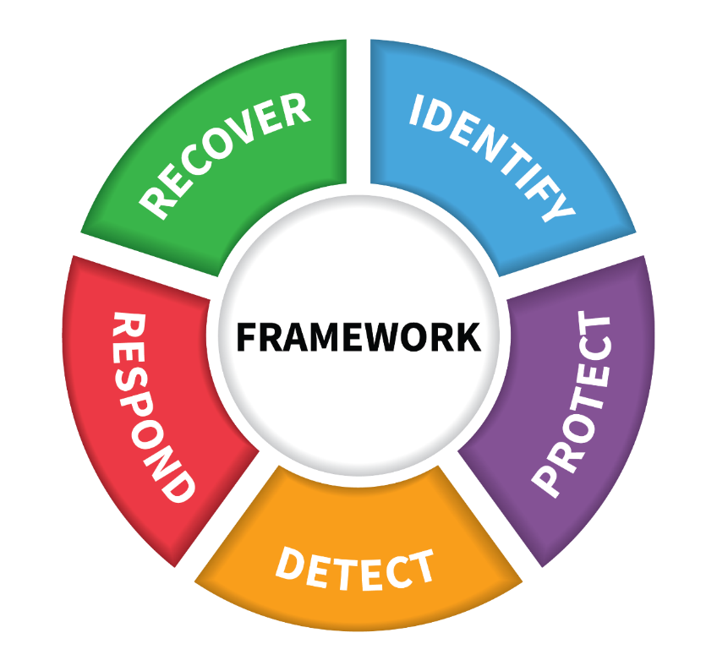
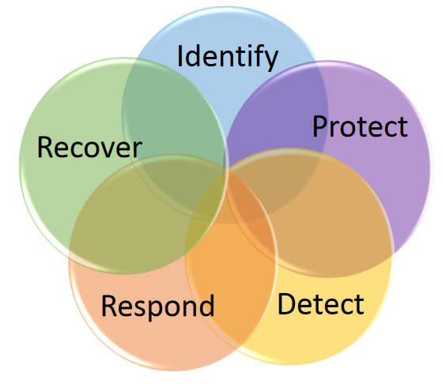
NIST Security
Cybersecurity Framework
Information Security
Notes:
Cybersecurity = Prevention of damage to, protection of, and restoration of computers, electronic communications systems, electronic communications services, wire communication, and electronic communication, including information contained therein, to ensure its availability, integrity, authentication, confidentiality, and nonrepudiation.
• Physical Security: the protection of property, e.g. using fences and locks; • Personnel Security: using background checks; • Contingency Planning and Disaster Recovery: how to resume normal operations after an incident, also known as Business Continuity Planning; • Operational Security: protecting business plans and processes, and • Privacy: protecting personal information.

Slide 5
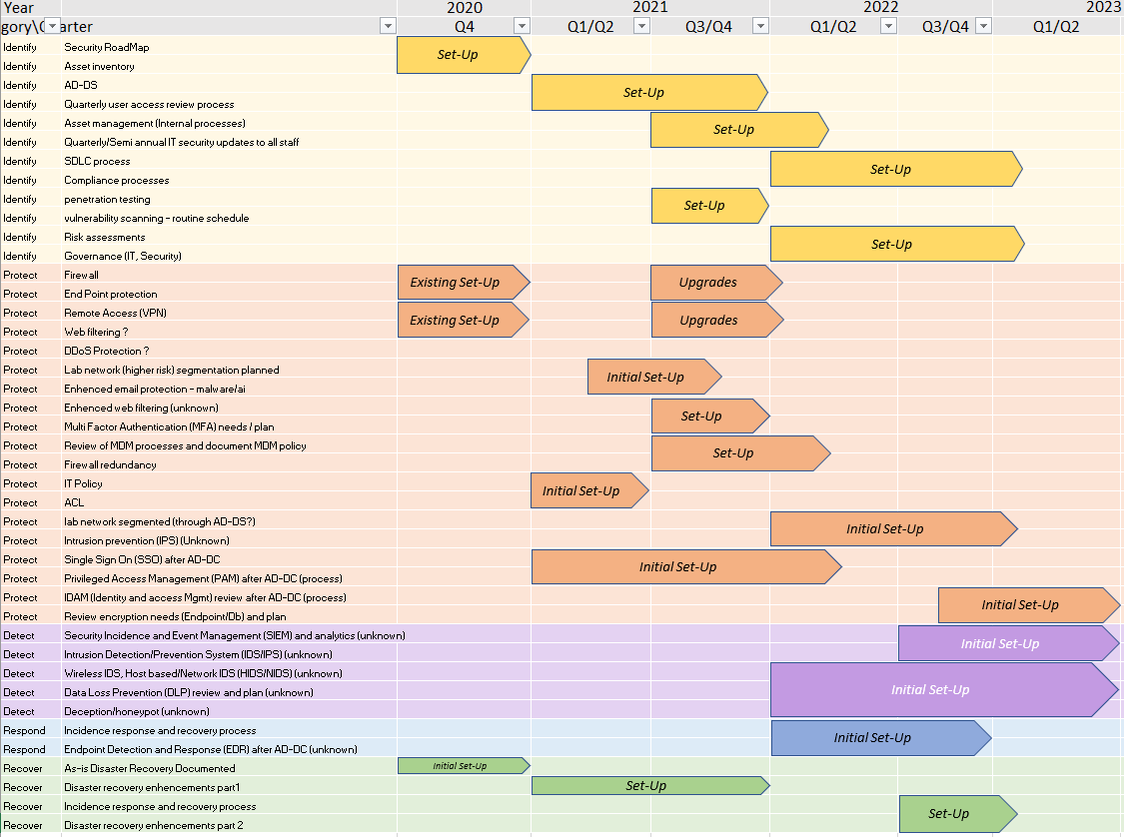
IT Security Roadmap

Slide 6
Backup Strategy: following “3-2-1 rule”
3 copies of all data
2 types of storage media
1 copy is off-site
RBX LAN
Other Key Features:
Main data repositories:
O365
Dell DP-4400
Benchling (eLN)
Azure
Server 1 & 2
(Paylocity, NetSuite, DotCompliance)
All data transfers use secure protocols
Cloud archives:
OneDrive
rbx-1
10.2.8.41
Helium
10.2.8.50
Data flows
Backups
rbx-2
10.2.8.44
Notes:
Cloud service providers have their own backup strategy, NIH docs are exception

