Slide 1
GOVERNANCE, RISK MANAGEMENT, AND COMPLIANCE (GRC)
These slides demonstrate governance for executives and security, showing how the environment is controlled.
10 Pages 20-1224

Slide 2
governance, Risk Management, and Compliance (GRC)

Slide 3
AGENDA
Objective: demonstrate commitment to security and compliance at launch
The Cloud is different
State of the [ORG] Microsoft 365 Cloud
Governance, Risk Management, and Compliance (GRC)
Controls and Features Demonstration
MindShift access for PNW colleagues
Q&A

Slide 4
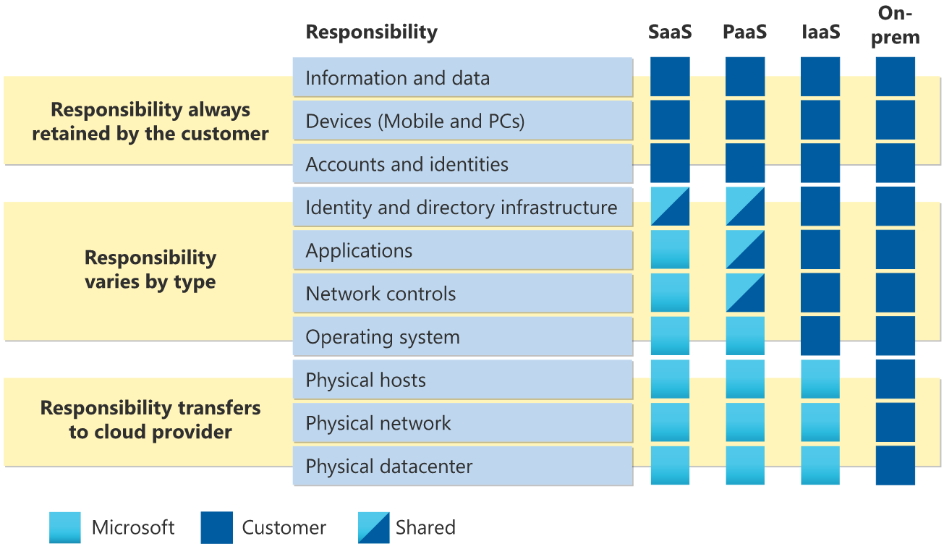
Cloud Basics
Easy to start, costly to run responsibly
Less predictable – annual agreements common, constant changes
Requires initial and ongoing scrutiny
Shared responsibility, limited provider liability
Image source: https://docs.microsoft.com/en-us/azure/security/fundamentals/shared-responsibility
SaaS – “Service as a Service”, PaaS – “Platform as a Service”, IaaS – “Infrastructure as a Service”
Notes:
Easy to make big mistakes on the internet
Traditional parameter is the data center firewall. Parameter on the Cloud is Identity and Authentication (and flawless configuration)
Question: Who is responsible for a breach of customer data? We are…

Slide 5
Cloud services
~__ contracted, ____+ used*
I. Company Policy, Process, and Standards
Owner identifies business need, secures funding, and organizational support
Identify and evaluate service providers and service levels
Legal review of terms, privacy, contract
IT / Security review and risk assessment
Agree on governance and support structure
Negotiate and contract
Establish vendor with finance
Implement governance and support plan
Use, support, monitor, and manage
Repeat annually
Applicable: Vendor Contracting Policy, Cloud Computing Policy and Standards, Compliance Guide
II. Shadow IT
Click-through agreement
Pay with credit card, or free service
III. Fourth Party
Vendor / Partner solution
Legal review
Security risk assessment
Click-through agreement
IV. Personal or Automatic Use
Browse website / connect
* Current service catalog: _______________
Apps used report: Cloud Discovery - Microsoft Defender for Cloud Apps (cloudappsecurity.com)

Slide 6
Shared Responsibility
Owner Drives and Supports, Legal and Info Sec Define and Verify, Committees Review and Approve, Admins Implement, End Users are Responsible
GRC
Service Owner
Legal
M365 Committee
Tenant Admins
End Users
Change Advisory Board
Information Security

Slide 7
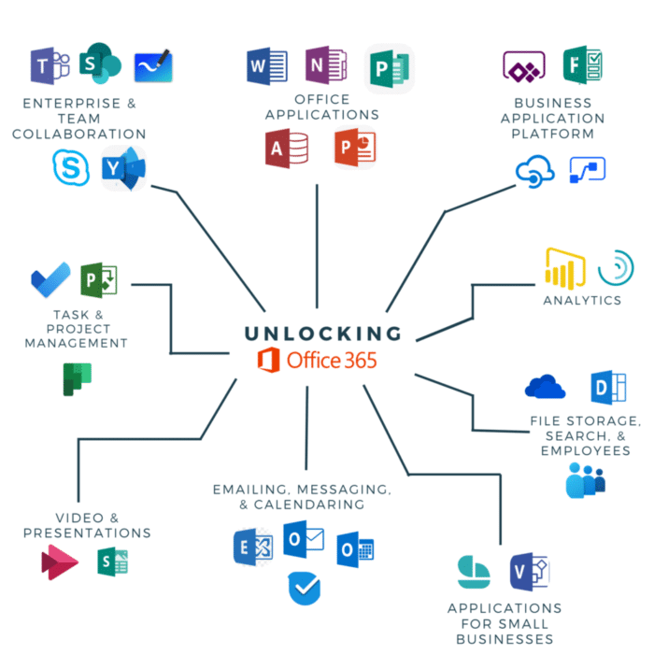
Microsoft 365 Productivity services
[ORG] owns an E5 License – the best
Status of Services and Governance
Deployed (or Available)
Outlook
Teams
Power BI
Planner
Whiteboard
Forms
My Analytics
Viva Insights
In Progress
SharePoint Online
One Drive (currently in pilot)
Viva Connections
Business Voice (phone service)
Under Consideration
Power Automate
To Do
Approvals
Image source: https://www.thinkebiz.net/business-automation/microsoft365/
Not Formalized
Emerging
Established

Slide 8
Getting to Green
Cloud operations take time to establish and support. For example:
Not Formalized
Emerging
Established
May be in production
One or more people have admin rights
May be compliant with [ORG] Cloud Standards
Unclear where data are stored and what data are processed
Accountable Service Owner
M365 Committee informed (if Microsoft services)
Documented Governance and/or Terms of Use
Clear understanding of where data are stored
End User support / Service Catalog
Initial Security Review
Strong technical controls, such as Data Loss Prevention (DLP) and Advanced Information Protection
Change management, including M365 committee oversight, if applicable
Mature support process, including automation and risky events (terms and transfers)
Auditable adherence to [ORG] policy
Regular reviews against established security baseline
Alerts and/or SIEM integration
Retention policies
Offline Backups

Slide 9
M365 Controls
Identity and Access Management are the Cloud Perimeter; Preventative and Detective Controls make up the rest
Admin / Procedural
Corporate Policy
IT Standards
Governance Plan
Terms of Use
IT Service Management Process
Security and Awareness Training
Compliance Training
eDiscovery/Records Management
Vendor Risk Assessment*
Internal Audit*
Alert / Incident Management*
Compliance Manager**
Communications Compliance**
Technical
Single Sign-On (SSO)
Multi-Factor Authentication (MFA)
Mobile Device Management (MDM)
Data Loss Prevention (DLP)
Conditional Access (USAL computers and enrolled mobile devices)
External Sharing Limits
Audits and Logs
Safe Links
Virus Scanner
Retention Policies*
Data Classification*
Rights Management (AIP)**
* control not implemented universally or completely
** future deliverable
Notes:
About risk management in the Microsoft Cloud:
https://docs.microsoft.com/en-us/azure/cloud-adoption-framework/govern/security-baseline/policy-statements

Slide 10
Implementation details
Services In-Scope, compared to established services
Deployed Services | Description | Support | Gov. | Terms of Use | DLP | Offline Backup | Ret. Policy | Other
 | Corporate email and calendaring system | Established | Yes/ No/ Soon | Yes/No | Yes/ No/ Soon | Yes/ No/ Soon | Yes/ No/ Soon
 | Corporate chat, presence, and video conferencing. Conversation-based collaboration and file authoring / storage space | Emerging | Yes/ No/ Soon | Yes/No | Yes/ No/ Soon | Yes/ No/ Soon | Yes/ No/ Soon
 | Online version used in two places: Share tenant and as back-end for Teams. On-Premises runs Intranet, Workspaces, Projects, and References sites; is backed up | Established | Yes/ No/ Soon | Yes/No | Yes/ No/ Soon | Yes/ No/ Soon | Yes/ No/ Soon
 | Will replace the personal Drive. 1TB per user, pooled across the organization. Auto-sync across devices. Built into the Windows OS and Teams as a default save and auto-save location for files. | Emerging | Yes/ No/ Soon | Yes/No | Yes/ No/ Soon | Yes/ No/ Soon | Yes/ No/ Soon
 | Business intelligence and reporting application. Rolled out by USAL business, now operated by IT. Large user base. | Emerging | Yes/ No/ Soon | Yes/No | Yes/ No/ Soon | Yes/ No/ Soon | Yes/ No/ Soon
Support = dedicated staff, service catalog, automation scripts Gov. = documented governance plan, representation at the M365 committee, auditing abilities Terms of Use = published end-user policy, terms of use, or other produced by [ORG] DLP = Data Loss Prevention (intervenes when sensitive data transacts) Offline Backup = the ability to copy configuration and data in the [ORG] data center to restore configuration and other major mistakes Ret. Policy = a retention policy is in place

Slide 11
DEMO
Controls and Features in the Microsoft 365 Cloud
Data Loss Prevention (DLP)
Communications Compliance
Audit Log
eDiscovery

