Slide 1
ENTERPRISE GRADE SECURITY
The following was presented at a NOREX International Roundtable. It outlines how one organization created their security operation while staying within their budget.
11 Pages 20-1218

Slide 2
Enterprise Grade Security On a PB & J Budget

Slide 3
Operating in 21 States
WA
ID
Midwest
Minnesota
Wisconsin
Iowa
North Dakota
South Dakota
Nebraska
Indiana
South
Alabama
Florida
Mississippi
North Carolina
West
Washington
Arizona
California
Nevada
Hawaii
East
New York
New Jersey
Rhode Island
West Virginia
Virginia
MT
ME
OR
ND
MN
MI
VT
NH
SD
WI
NY
CA
WY
MA
NV
IA
PA
CT
RI
UT
NE
IL
OH
NJ
CO
IN
WV
DE
MO
MD
KS
VA
KY
AZ
NM
NC
OK
TN
TX
AR
SC
MS
AL
GA
AK
LA
FL
HI

Slide 4
IT Overview
~60 FTEs
$19.5MM total IT budget
$950K total Cybersecurity budget including (3) staff
4.9% of total IT spend

Slide 5
We all have the same challenges
Threats are constantly evolving
Limited resources for many organizations
How do you know your defenses will protect you when it counts?
Everything is a priority related to Cybersecurity – how to choose?
We have to win every day,
The “bad guys” only have to win once.

Slide 6
Key Principles
Know what really matters to your organization
Attitude is everything
Be curious and relentless
Never be satisfied with “good enough”
Excel at the basics
Ask the tough questions, and ask all the time
Security is everyone’s responsibility

Slide 7
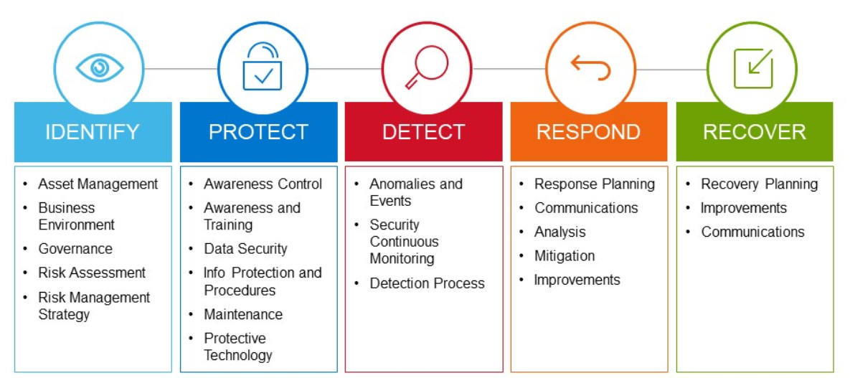
Where to start?
NIST Cybersecurity Framework

Slide 8
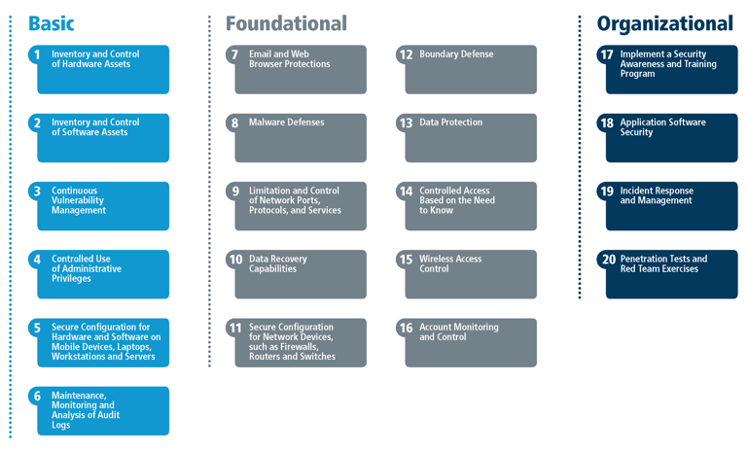
How to prioritize?
CIS Controls V7
Critical Gap
Partial Gap
CIS Controls V7
Adequate

Slide 9
What tools do you pick?
Don’t buy 110 features and use 12
Do buy 10 features and use 9
Ensure your team can implement
Ensure your team can manage
Price = Value

Slide 10
DIY or Outsource?
DIY
SIEM
EDR
NDR
Hire 5 Analysts
Outsource
SIEM (joint / on-prem)
24x7 SOC
EDR
NDR
MDR
$1.6MM Capital
$1.0MM OPEX
$25K Capital
$300K OPEX

Slide 11
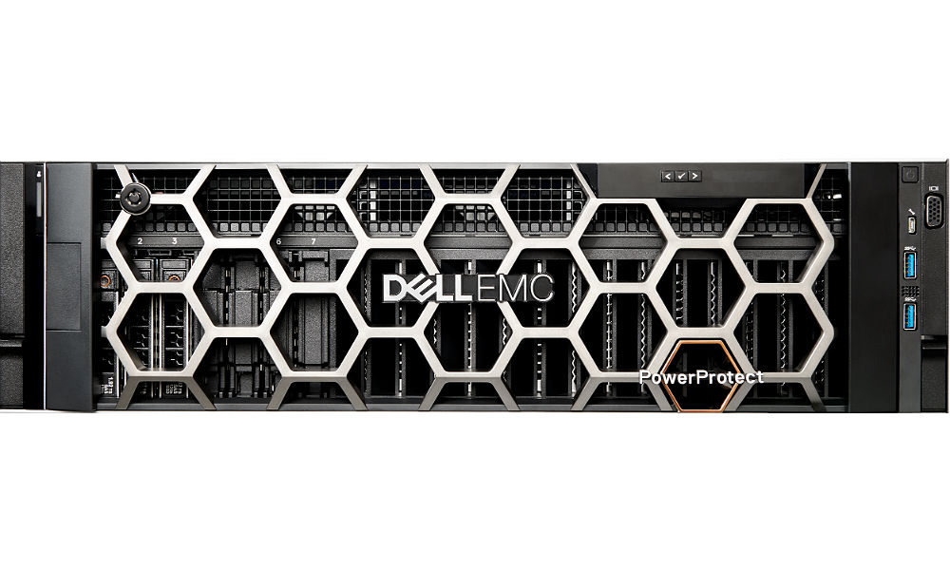
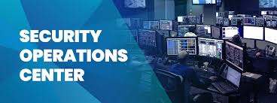
Security Program Tools
1
IDPA &
Secure Vault
AV Layer 1
2
AV & EDR
Layer 2
1
2
7
8
3
4
3
5
6
8
4
7
5
EDR Layer 1
6

Slide 12
Security Program on a Page
Train and Test our Users
Acceptable Use Policy
Security Awareness Training
Monthly Phishing Testing
Deliver the Fundamentals
Device Management
Patching & Software Updates
Vulnerability Management
24x7 Security Operation Center
Incident Response
Table Top Exercises
Test our Defenses
Penetration Testing
Breach Attack Simulation
Formal NIST / CIS Assessments
New Capabilities
Identity & Access Management
Further leverage AI & ML
Routinely evaluate our tools & processes
Respond to new threats as they emerge

