Slide 1
PORTFOLIO PLAN TEMPLATE
This dashboard shows examples of planned and completed projects, color-coded status, and comparisons to previous years.
7 Pages 20-1178

Slide 2
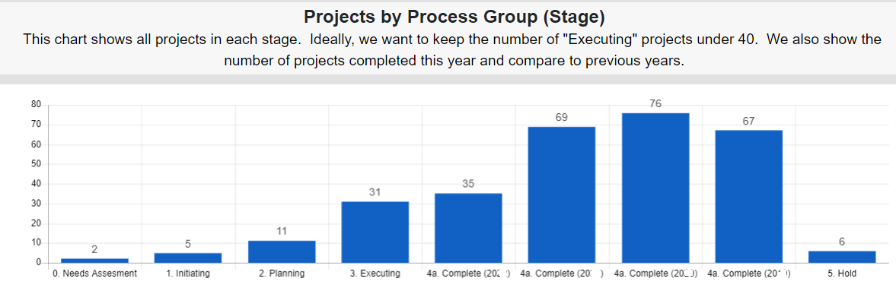

Slide 3
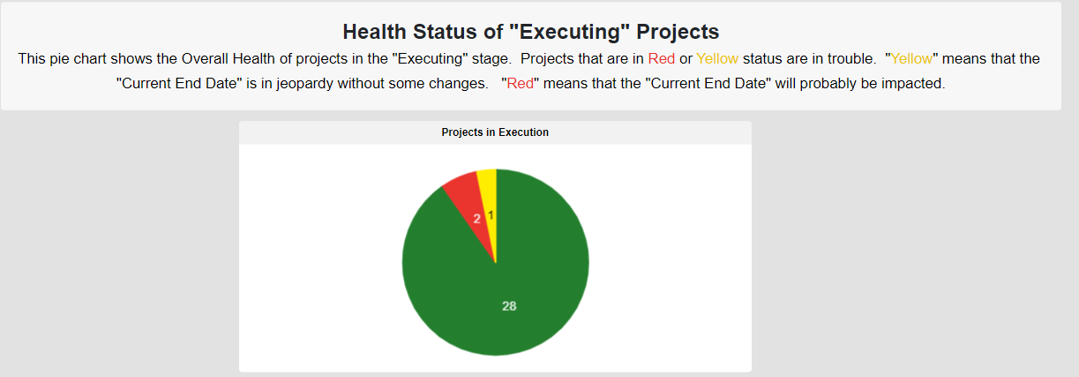

Slide 4
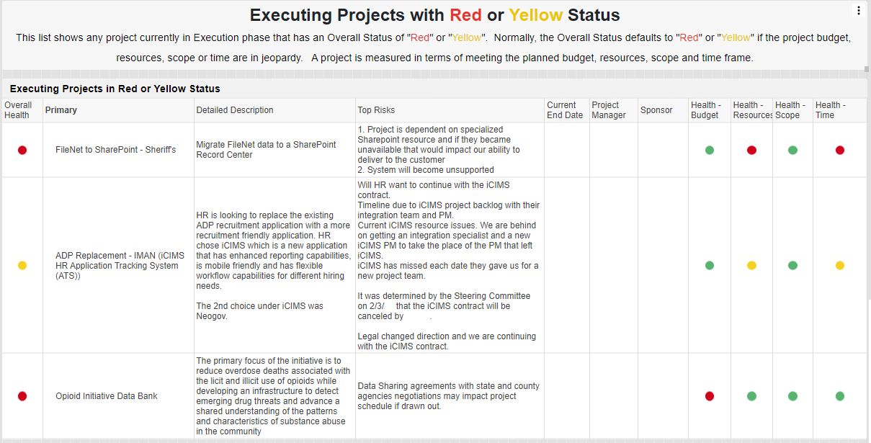

Slide 5
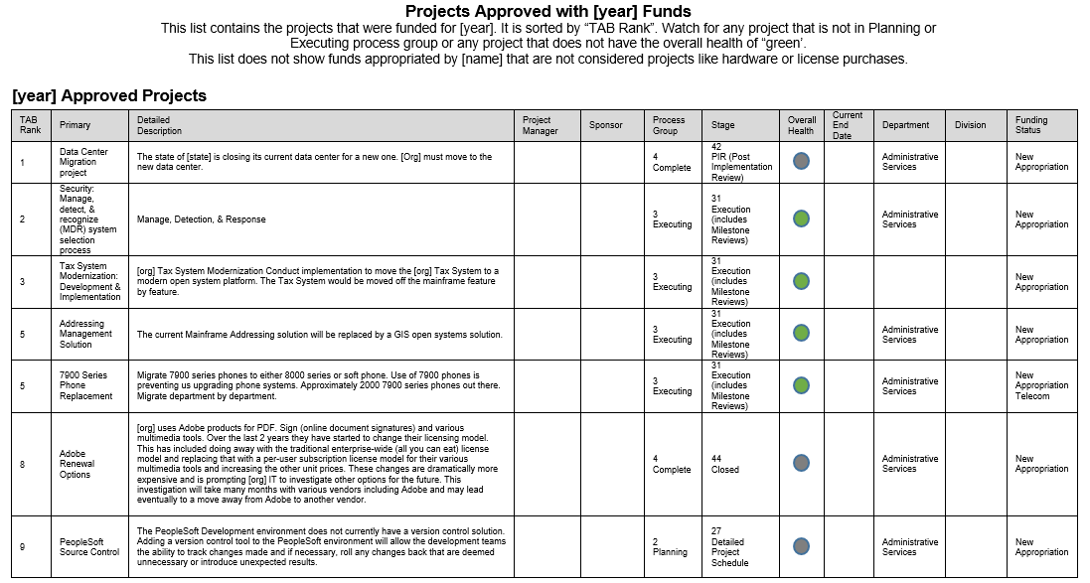

Slide 6
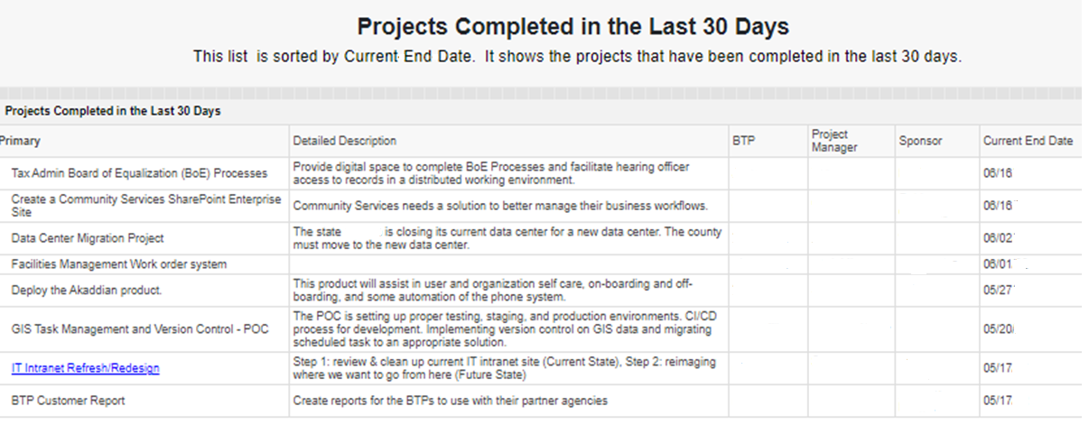

Slide 7
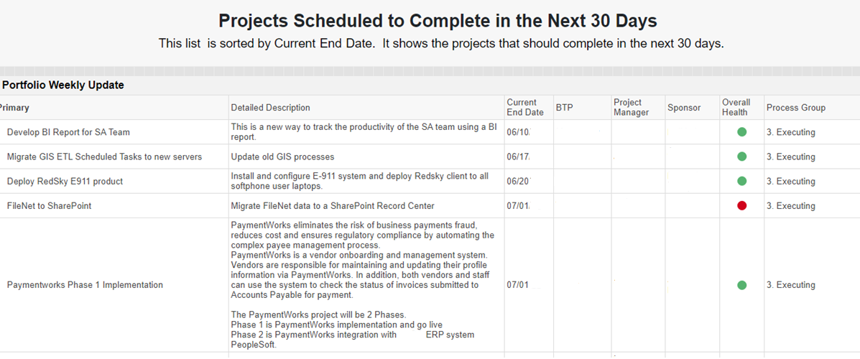

Slide 8
