Slide 1
SYSTEMS DEVELOPMENT LIFE CYCLE
This presentation describes phases of system and software development including Agile.
8 Pages (20-1119)

Slide 2
Systems Development Life Cycle

Slide 3
Purpose / Definition
To assess and establish the Systems Development Life Cycle
Systems Development Life Cycle (Definition)
A systems development life cycle is composed of a number of clearly defined and distinct work phases which are used by systems engineers and systems developers to plan for, design, build, test, and deliver information systems. Like anything that is manufactured on an assembly line, an SDLC aims to produce high quality systems that meet or exceed customer expectations, based on customer requirements, by delivering systems which move through each clearly defined phase, within scheduled time-frames and cost estimates. Computer systems are complex and often (especially with the recent rise of service-oriented architecture) link multiple traditional systems potentially supplied by different software vendors. To manage this level of complexity, a number of SDLC models or methodologies have been created, such as "waterfall"; "spiral"; "Agile software development"; "rapid prototyping"; "incremental"; and "synchronize and stabilize.
Wikipedia - http://en.wikipedia.org/wiki/Systems_development_life_cycle

Slide 4
Systems Development Life Cycle Phases
Concept Phase: This is the project initiation phase. The objective of this phase is to conduct a preliminary analysis, propose alternative solutions, describe costs and benefits and submit a preliminary plan with recommendations.
Requirements/Design Phase: Requirements: defines project goals into use cases of the intended system. Analyzes end user information needs. Design: Describes desired features and operations in detail, including screen layouts, business rules, process diagrams, pseudocode and other documentation as needed.
Build, Test & Implement Phase: This is where the code is written, we are building the system in this phase. Additionally, testing also takes place during this phase (unit & user testing). Finally, this phase of the life cycle also includes the implementation (promote to production) aspect of the new system.

Slide 5
Systems Development Life Cycle (SDLC)
Concept Phase
Requirements/Design
Build, Test & Implement
Key Activities
Review all available documents
Prepare project charter
Prepare High Level project plan
Hold project / phase kickoff meeting
Establish, monitor, and control scope, schedule, and budget
Update Business Case
Invoke change control as needed
Formally close concept phase
Key Outputs
Approved project charter
High Level project plan
Approved business case
Concept phase closure report
Key Activities
Hold phase kickoff meeting
Prepare business functional & technical requirements document
Specify test requirements
Design tests (test cases)
Create architectural design documents & drawings
Architecture review
Prepare detailed Project Plan
Prepare Master Test Plan
Key Outputs
System Requirements document
Detailed Project Work Plan
Master Test Plan (Test Cases)
Requirements / Design Phase Closure document
Key Activities
Hold Phase Kick-off Meeting
Construct & Test product deliverables per Project Plan
Prepare Training Materials and Train impacted staff
Prepare Operational Readiness Document
Monitor & Control Scope, Schedule, and Budget
Execute Master Test Plan
Complete & Execute Tests & Manage Defects
Update Change Control Log
Scope Verification with key Stakeholders & Sponsor
Formally Close Build/Test/Implement Phase
Notify all stakeholders of project closure & assess satisfaction
Obtain system-owner acceptance / sign-off
Deploy production system / application on “go-live” date
Update all project documents & drawings to the “as built” state
Place up-to-date project documents in SharePoint Project Site
Prepare & Issue Project Closure Report
Assess stakeholders’ satisfaction with the project
Key Outputs
Completed, tested and user accepted product deliverables
Approved Master Test Plan
Approved UAT Report
Completed Training Materials
Updated Issues, Decisions & Lessons Learned
Approved Operational Readiness Report
Updated Project Plan
Updated Budget
Build/Test/Implement Phase Closure Report
System / application “In Production”
Signed System Acceptance
Up-to-date / “As Built” project documentation
All stakeholders notified of project completion
Project Closure Report
Yes
Revise & Update
Charter & Bus. Case
Acceptance?
Revise & Update
Requirements & Design
Acceptance?
Revise & Update
User & project Sponsor
Acceptance?
Yes
No
No
No

Slide 6
Document Outputs by Phase
Concept Phase
Business Case (Business Project Sponsor)
Project Charter (Project Manager)
Initial Project Plan (High-Level) (Project Manager)
Initial Requirements (High-Level) (Business Analyst)
Requirements/Design Phase
Detailed Project Plan (Project Manager)
Requirements Document (Business Analyst)
Solution Architecture Document (Solution Architect)
System Design Specification Document (Solution Architect)
Test Cases (Business Analyst)
Build, Test & Implement
Open Items Log (Project Manager)
Change Request Log (Project Manager)
Operational Readiness Document (Business Project Sponsor)
Training Materials (Business Analyst)
Signed System Acceptance (Project Manager)

Slide 7
Software Development Life Cycle phases
The Software Development part also has phases
Elaboration: The Elaboration phase enables this software development team to get answers (elaborate) on requirements that are not clear or could have more than one solution
Solution Design: The Solution Design phase is where we design the end-to-end solution
Programming & Unit Testing: This is the software development phase (we are writing code). All custom code must be unit tested
User Acceptance Testing: End user validation & acceptance of the system
Beta Testing (Optional): This is a pre-go-live phase where a select group of users use / test the system prior to it going live

Slide 8
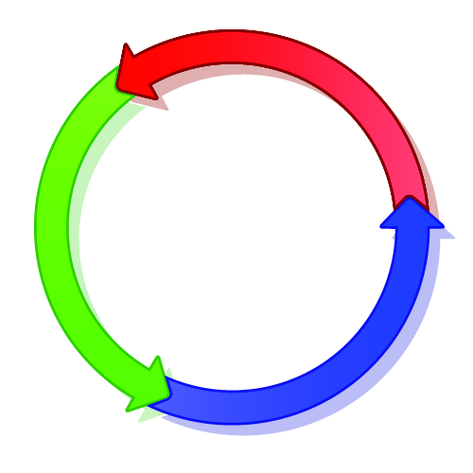
Agile software development
Agile software development is a group of software development methods in which requirements and solutions evolve through collaboration between self-organizing, cross-functional teams. It promotes adaptive planning, evolutionary development, early delivery, continuous improvement, and encourages rapid and flexible response to change
Wikipedia - http://en.wikipedia.org/wiki/Agile_software_development
Agile

Slide 9
Software Development Life Cycle (SDLC)
Production Launch
Requirements Document
Elaboration
Beta Testing
Agile
User Acceptance Testing
Solution Design
Programming &
Unit Testing
QA

